Slide 1
Smart safe LoCK
BY
Vinit Singh (CLASS ID: 36)
Akhil Bhavirisetty (CLASS ID: 3)
Saiteja Desu (CLASS ID: 7)

Slide 2
Introduction
Unlocking a digital safe lock is quite challenging
Cannot track suspicious persons
Virtual assistant with raspberry pi can solve this problem
Set up is portable and can be used in any application

Slide 3
Features
Easy to unlock
Need not to remember Password, security based on OTP
Take images of intruders
Send email alerts

Slide 4
Technologies / Hardware
Raspberry Pi 2
USB Microphone
Speaker
Python Scripting
Pi Camera
Email(IMAP Protocol)

Slide 5
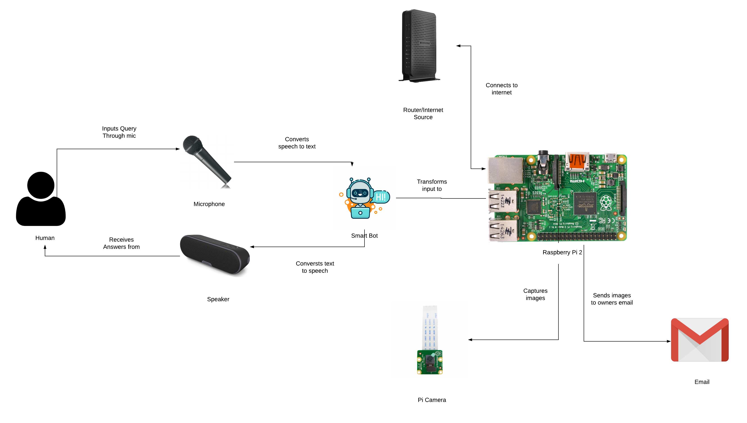
ARCHITECTURE DIAGRAM

Slide 6
demo

Slide 7
challenges
Defective Hardware
Delicate set up
Voice Recognition
Performance
Configuring Email and Message Notification service

Slide 8
Future work
Unlocking safe lock set up
Can be able to authorize by face/voice
Live streaming of room when not at home
Making it more compact and portable

Slide 9
Thank You

